Slide 1
Go to our website at friends-nhcarboretum.org
To log in, click gray Log in box

Slide 2
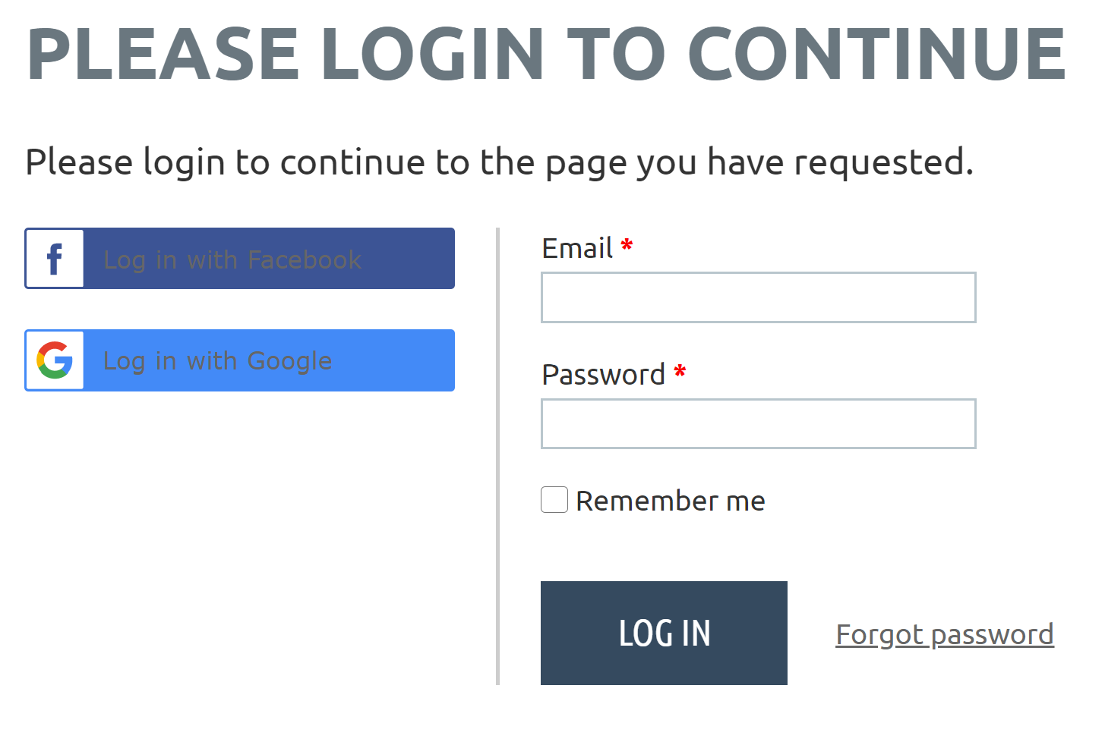
If first time logging in, click Forgot password

Slide 3
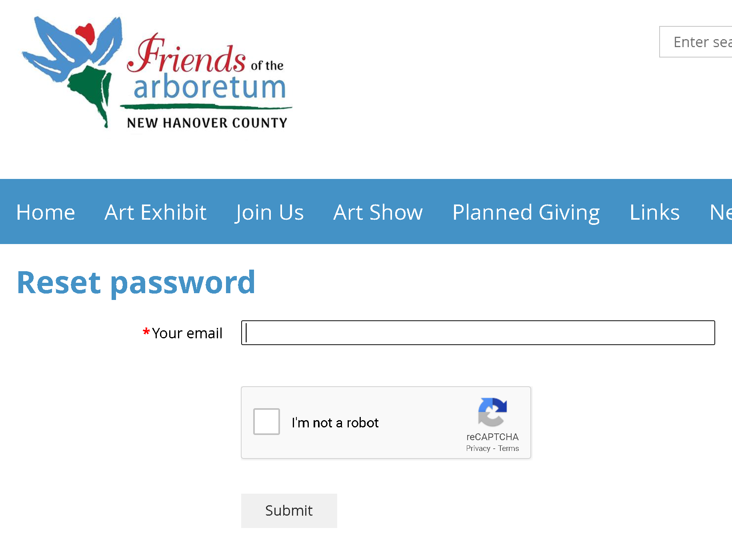
Enter your email address, click the I’m not a robot box, then Submit

Slide 4
You should get this message screen

Slide 5
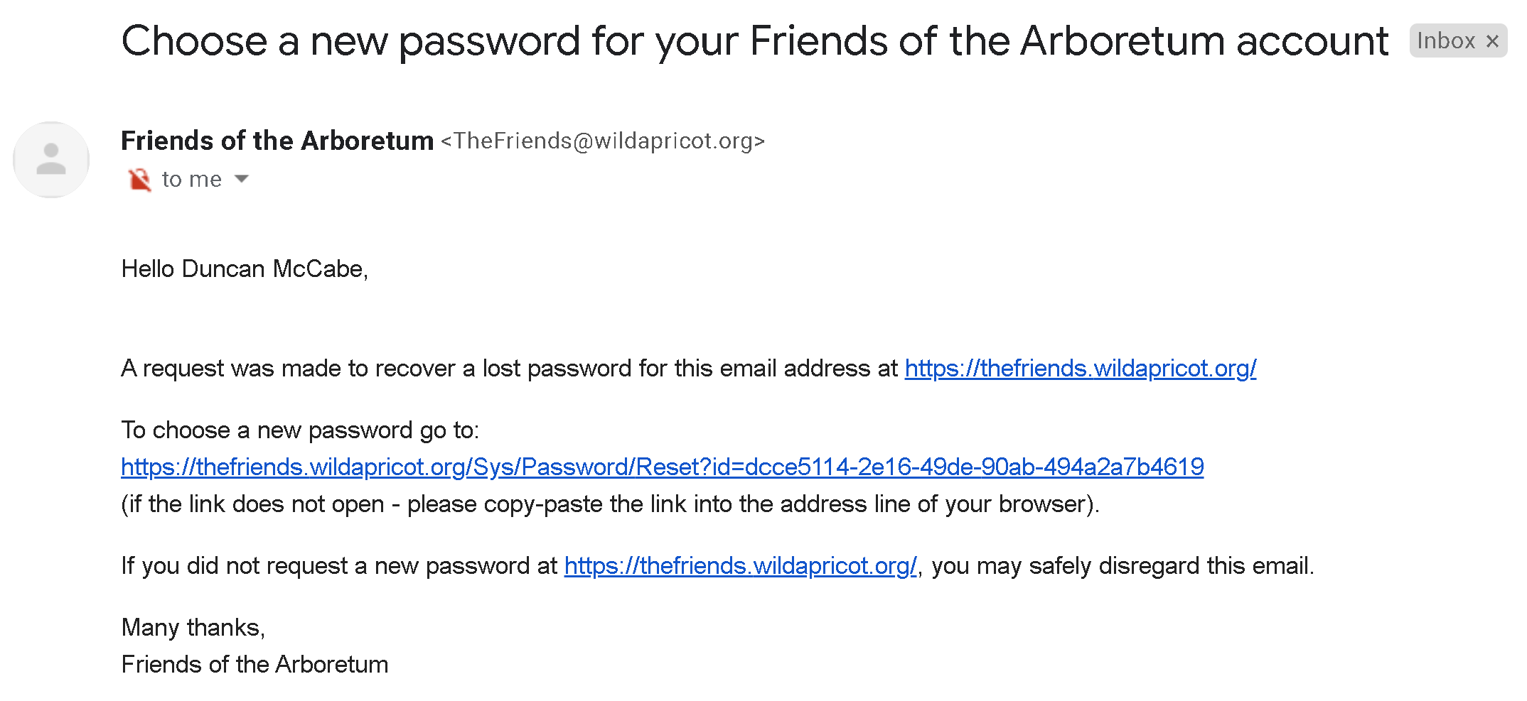
Now log in to your email account, look for this email, and click the link:

Slide 6
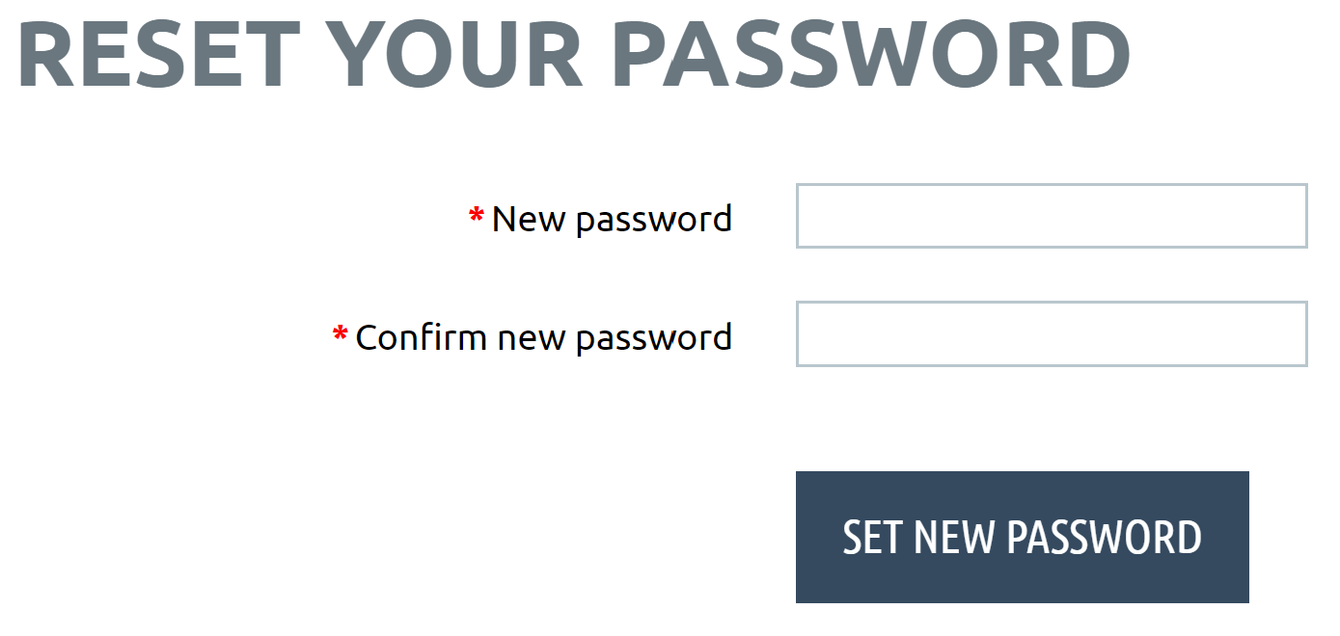
Type your password in the boxes and click the link:

Slide 7
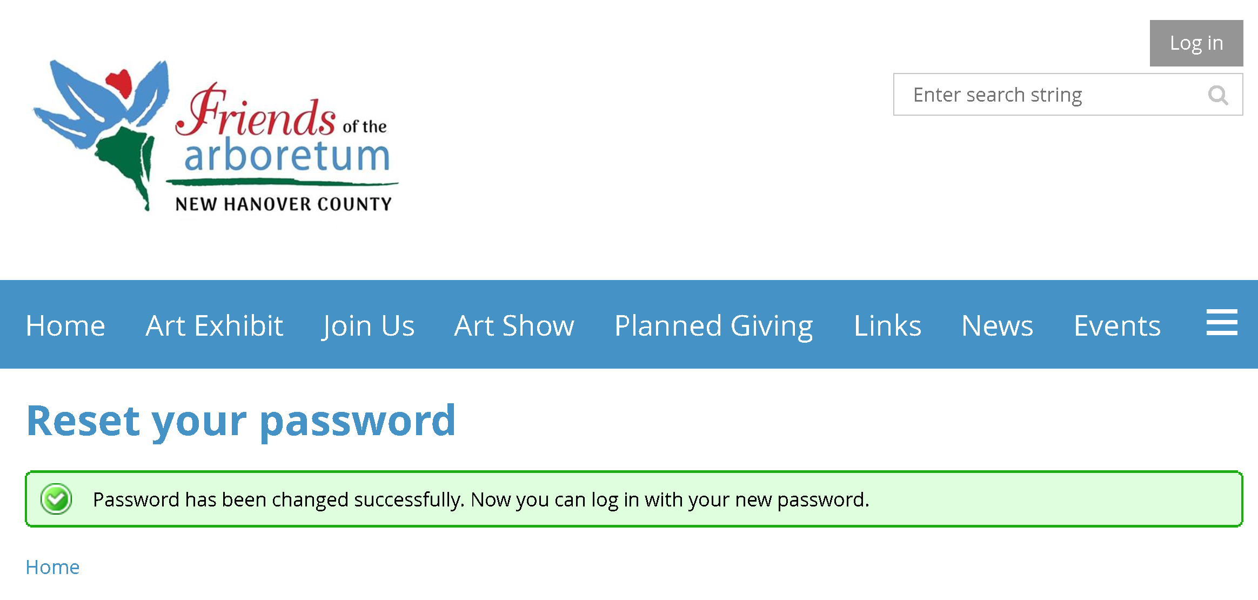
Now click the gray Log in box

Slide 8
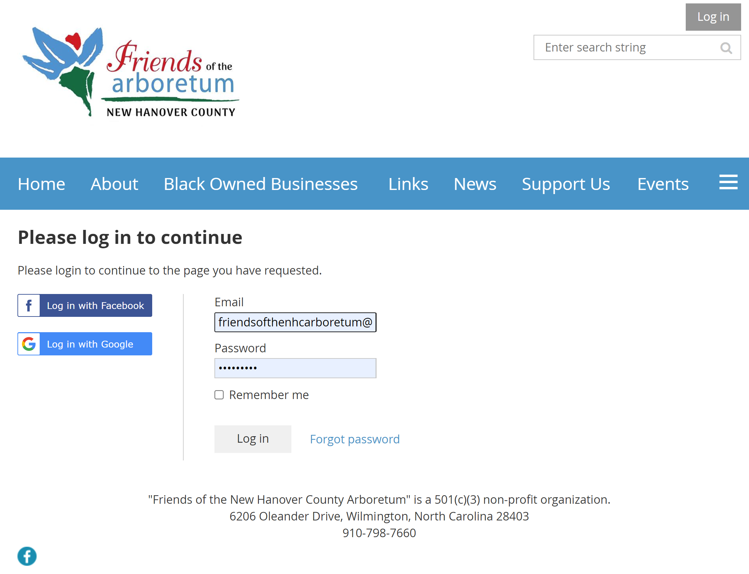
Enter your
Email and Password,
Check the Remember me box if you want your device to remember for the next time, then click
Log in

Slide 9
The first time you log in, you may see this screen. You must check the box, and click CONTINUE

Slide 10
You are now logged in. Click your name to view and edit your profile,
and print or download your membership card:

Slide 11
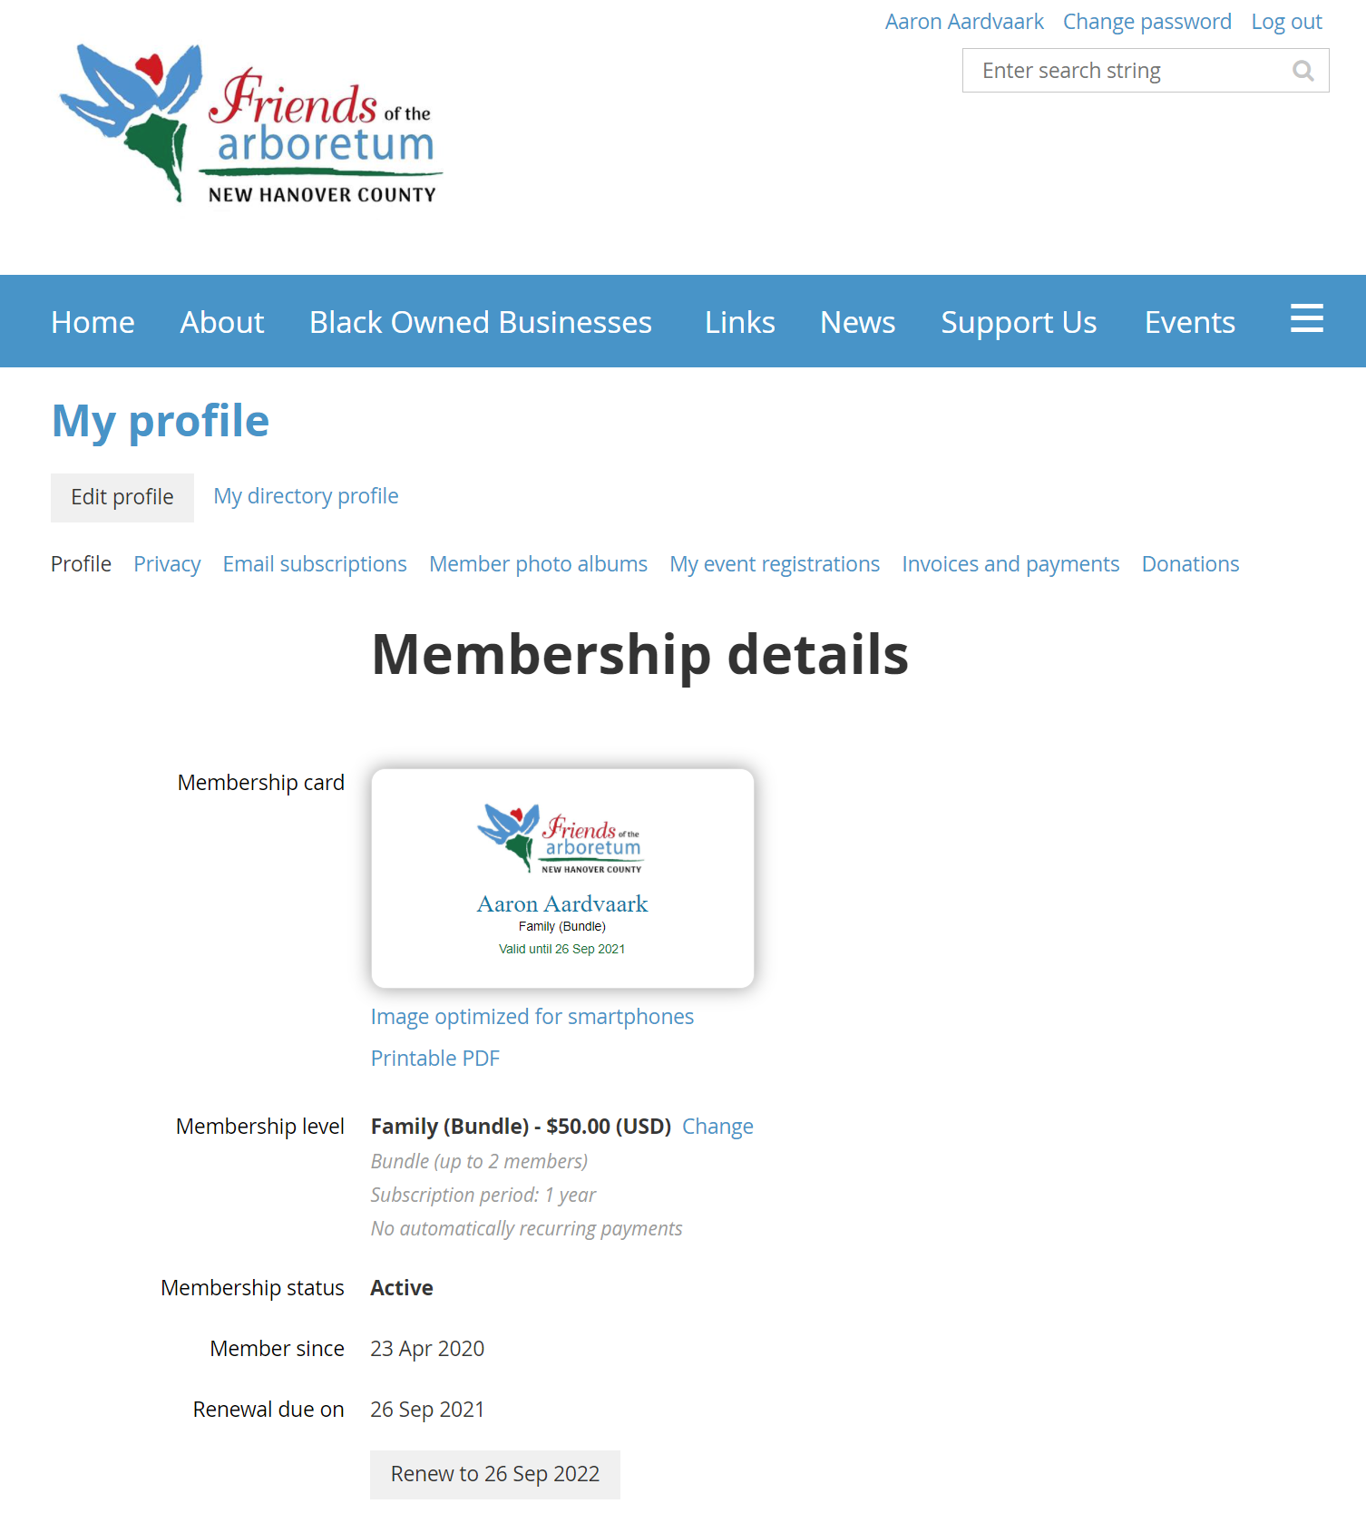
Edit profile
Membership card

Slide 12
Family and above memberships can include two people - these are called “bundled” memberships, and one member is the “administrator.” Only the administrator can renew the membership and access both profiles.

